Slide 1
Introduction to
International Business Administration

Slide 2
Global Production and Supply Chain Management
Notes:
This is a test

Slide 3
Prof. Dr. Amit Shah
Notes:
This is a test

Slide 4
Operations Strategic Objectives: Effect of Globalization?
Quality
Cost
Flexibility
  Quantity
  Product variety
Delivery Time
  Speed
  Reliability

Slide 5
Supply Chain Security: Reliability
The product or service
Information
Money
The logistics system

Slide 6
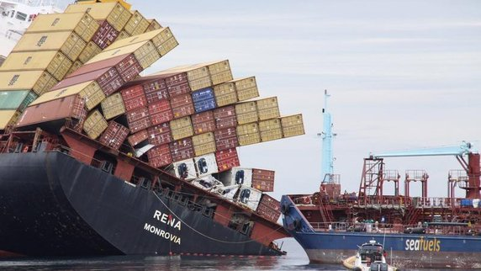
2000-10,000 containers are lost at sea per year.

Slide 7
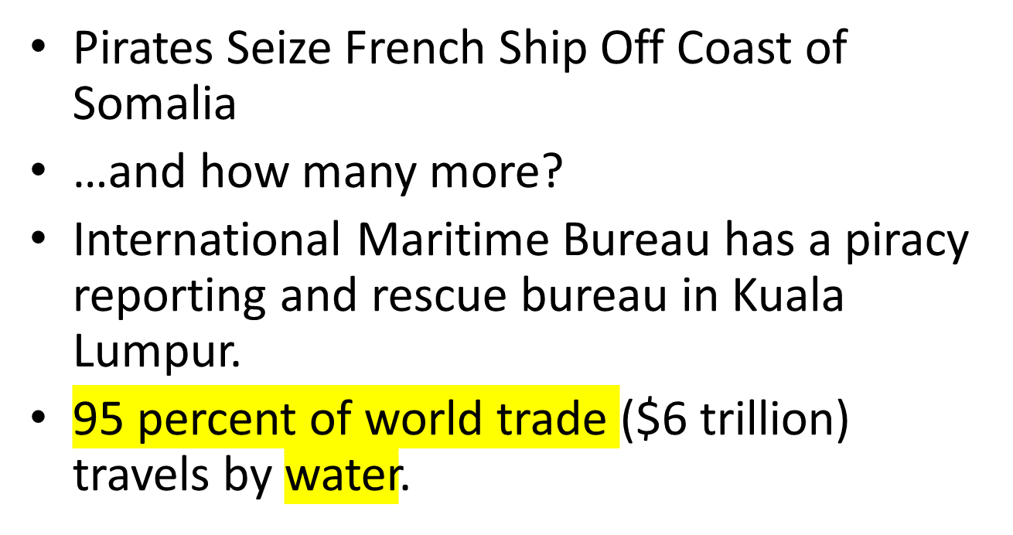
Piracy

Slide 8
Global Production
Advantages
Lower costs
Centralized functions
Economies of scale
Local talents
Disadvantages
Long supply chains
Exchange rate fluctuations
Remote from customers
Transportation arrangements
Cultural differences
Decisions not ‘sharp’
Notes:
Global production
Lower cost → source at a lot of places
Cost : usually the driving factor;
quality and reliability cannot be measured reliable, but transport, customs, warehouse can be measured

Slide 9
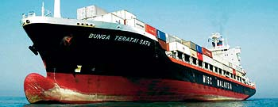
Speed?
Global Supply Chains can be long and depend upon slow transportation methods.

Slide 10
Where to Produce
The Hidden Costs of Foreign Locations
  High employee turnover.
  Shoddy workmanship.
  Poor product quality.
  Low productivity.
Notes:
Microsoft, for example, established a major facility in Hyderabad, India. However, the company found that the turnover rate among its Indian employees is higher than in the United States. Demand for software programmers in India is high, and many employees are prone to switch jobs to get better pay. Although Microsoft has tried to limit turnover by offering good benefits and long-term incentive pay, such as stock grants to high performers who stay with the company, many of the Indians who were hired locally apparently place little value on long-term incentives and prefer higher current pay. High employee turnover, of course, has a negative impact on productivity. One Microsoft manager in India noted that 40 percent of his core team had left within the past 12 months, making it very difficult to stay on track with development projects.

Slide 11
Make-or-Buy Decisions
Make-or-Buy Decisions
  Decisions about whether to perform a certain value creation activity in-house or outsource it to another firm.
  Main factors in the decision are cost and production capacity.
  Other factors include:
    Product success.
    Specialized knowledge.
    Strategic fit.
    Cost and production capacity.
    Supplier competencies.
    Inventory planning.
Notes:
Make-or-buy decisions are made at both the strategic and operational levels, with the strategic level being focused on the long term and the operational level being more focused on the short term. The decision of whether to buy or make a product is a much more complex and research-intensive process than the typical global firm may expect.

Slide 12
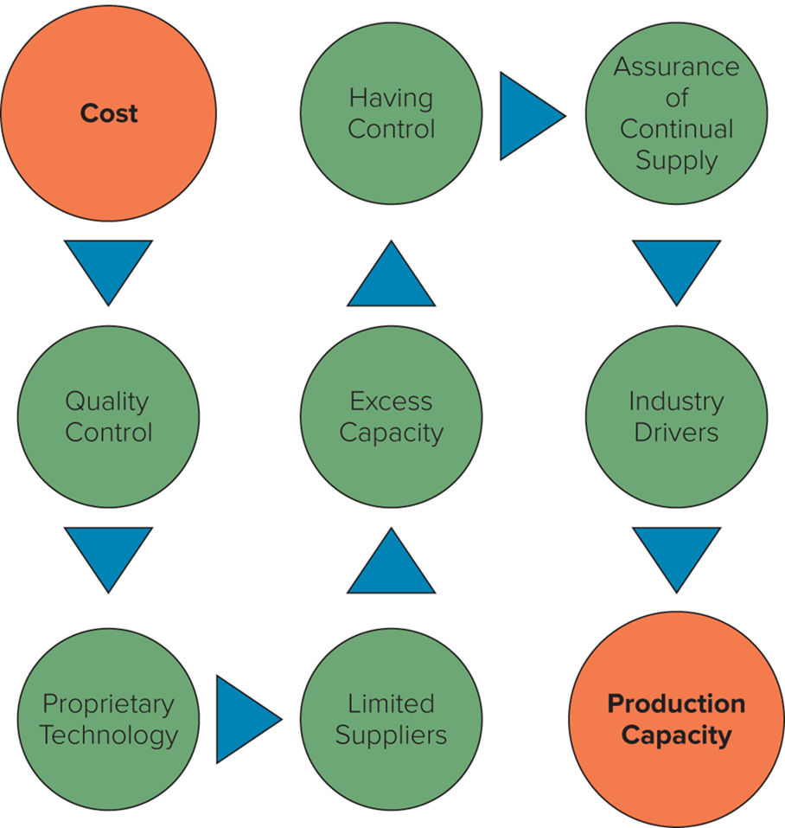
Operationally Favoring a Make Decision
Notes:
The elements that favor a make decision—beyond the core elements of cost and production capacity—include quality control, proprietary technology, having control, excess capacity, limited suppliers, assurance of continual supply, and industry drivers. After the cost and production capacity decisions have been explored and made (really, after the cost and production hurdles have been overcome), the next set of decisions follows logically from the path in the Figure.
Green dots are the factors you may need to consider → if any of those things are essential to your company/you don’t want to lose them → need to make it yourself

Slide 13
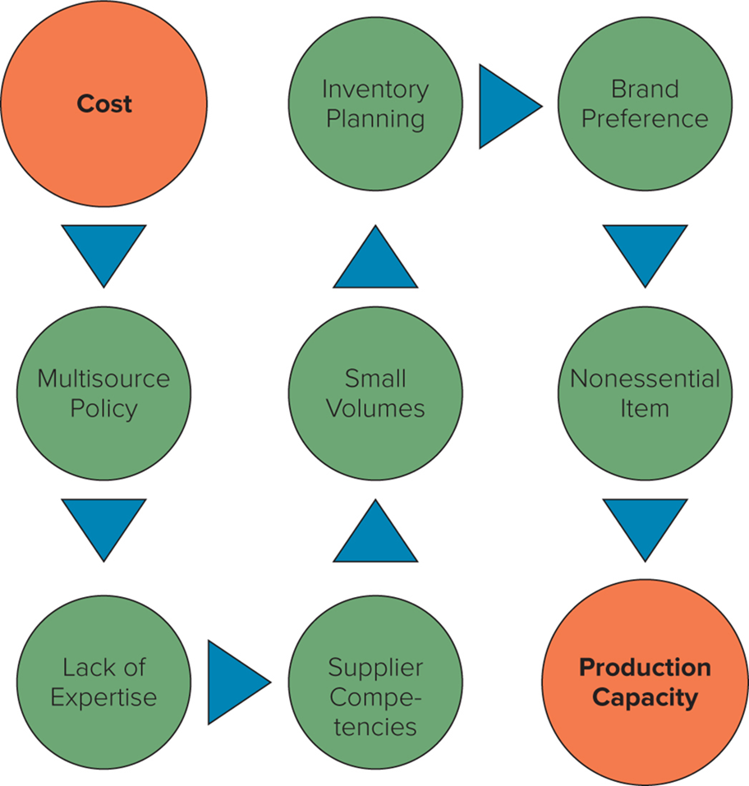
Operationally Favoring a Buy Decision
Notes:
As with the make decision, after the cost and production capacity decisions have been considered and made, the next set of decisions for the buy choice follow logically from the path in Figure above.
If any of those things are essential to you or you have those options → need to buy it

Slide 14
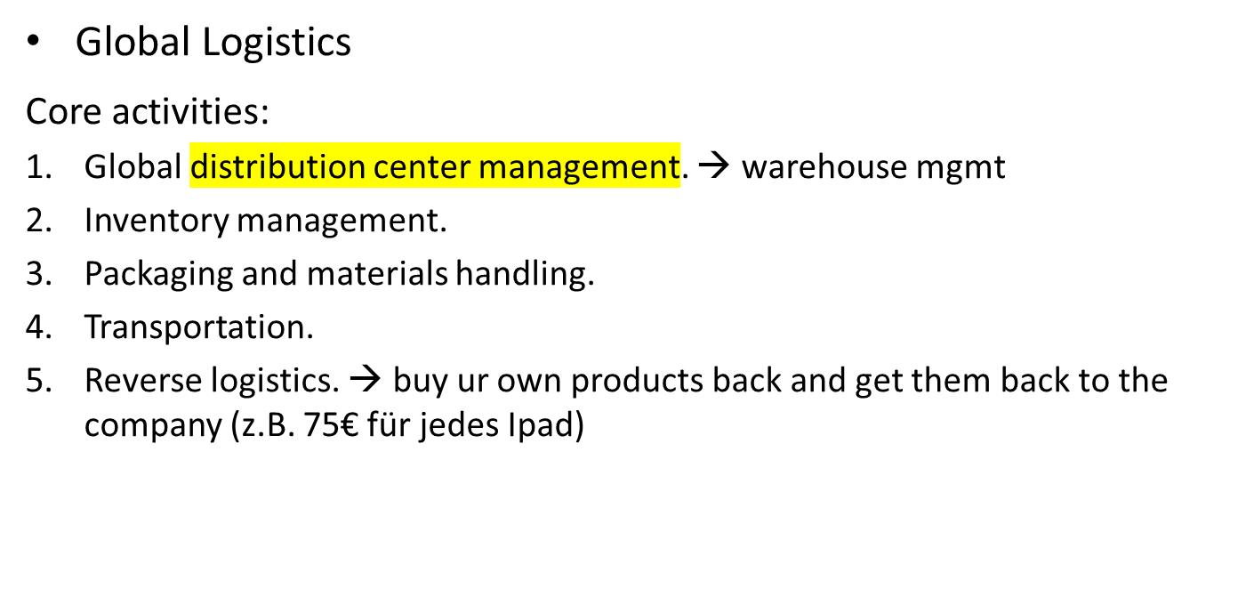
Global Supply Chain Functions
Notes:
Logistics is getting stuff from point a to point b

Slide 15
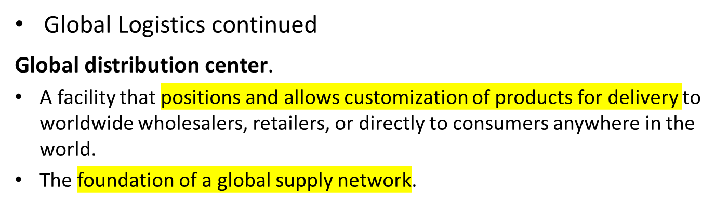
Global Supply Chain Functions
  Global inventory management.
    The decision-making process regarding the raw materials, work-in-process, and finished goods inventory for a multinational company.
    Get the most out of it with least holding cost
Notes:
Distribution centers (DCs) are used by manufacturers, importers, exporters, wholesalers, retailers, transportation companies, and customs agencies to store products and provide a location where customization can be facilitated.
Examining the largest 20,910 global companies with headquarters in 105 countries, we find that these companies, on average across all industries, carry 14.41 percent of their total assets in some form of inventory. These companies have 32 percent of their inventory in raw materials, 18 percent of their inventory in work-in-process, and 50 percent of their inventory in finished goods.

Slide 16
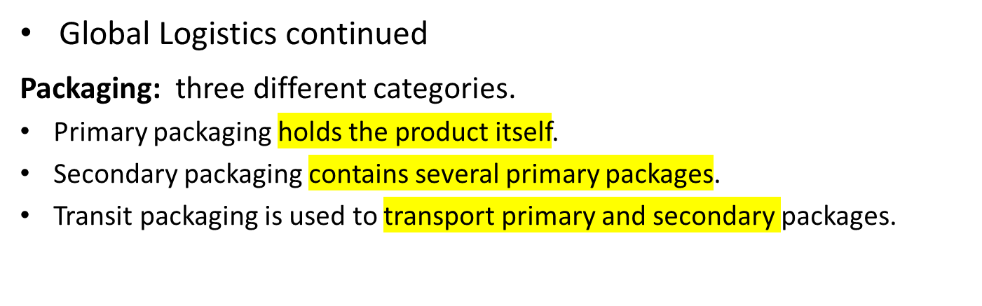
Global Supply Chain Functions
  The functions of packaging are to perform, protect, and inform.
Notes:
Perform refers to (1) the ability of the product in the package to handle being transported between nodes in the global supply chain, (2) the ability of the product to be stored for typical lengths of time for a particular product category, and (3) the package providing the convenience expected by both the supply chain partners and the end-customers.
Protect refers to the package’s ability to (1) contain the products properly, (2) preserve the products to maintain their freshness or newness, and (3) provide the necessary security and safety to ensure that the products reach their end destination in their intended shape.
Inform refers to the package’s inclusion of (1) logical and sufficient instructions for the use of the products inside the package, including specific requirements to satisfy local regulations; (2) a statement of a compelling product guarantee; and (3) information about service for the product if and when it is needed.

Slide 17
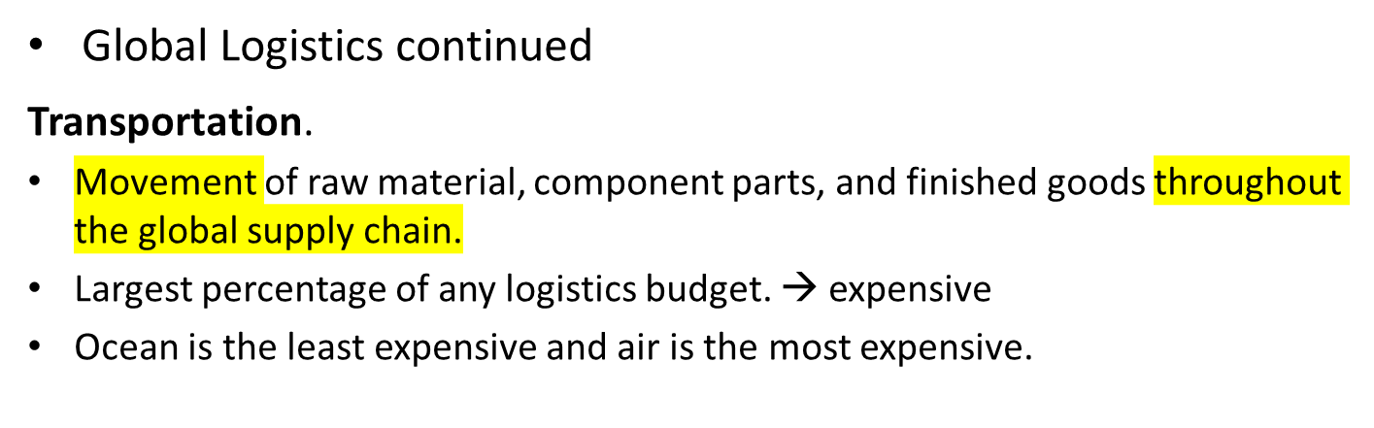
Global Supply Chain Functions 4
  Reverse logistics.
    Process of moving inventory from point of consumption to point of origin for the purpose of recapturing value or proper disposal.
    Ultimate goal is to optimize the after-market activity or make it more efficient.
Notes:
Transportation rates are heavily influenced by economies of scale, so larger shipments are typically relatively less expensive than smaller shipments. The characteristics of the shipment lso influence transportation rates through such factors as product density, value, perishability, the potential for damage, and other such factors. Finally, oil prices have a major impact on transportation rates because anywhere from 10 to 40 percent of most carrier costs, depending on the mode, are related to fuel.

Slide 18
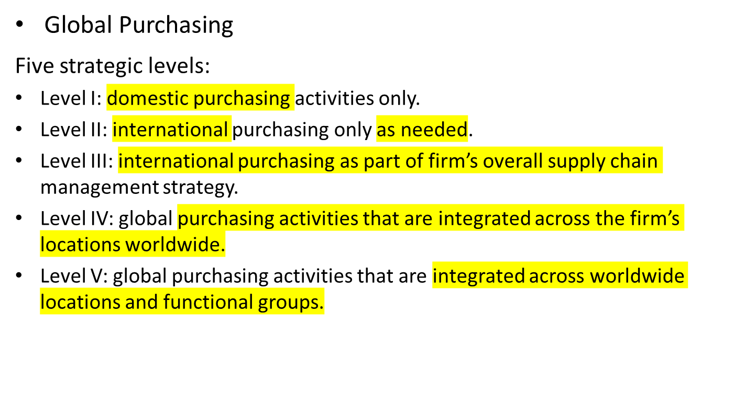
Global Supply Chain Functions 5
Notes:
Beyond the domestic, international, and global purchasing strategies in levels I through V, purchasing includes a number of basic choices that companies make in deciding how to engage with markets. The starting point is a choice of internal purchasing versus external purchasing—in other words, “how to purchase.” The next decision, in both internal and external purchasing, is to figure out “where to purchase” (domestically or globally). This takes us ultimately to the “types of purchasing” (where and how) and the four choices for purchasing strategy: domestic internal purchasing, global internal purchasing, domestic external purchasing, and global external purchasing.

Slide 19
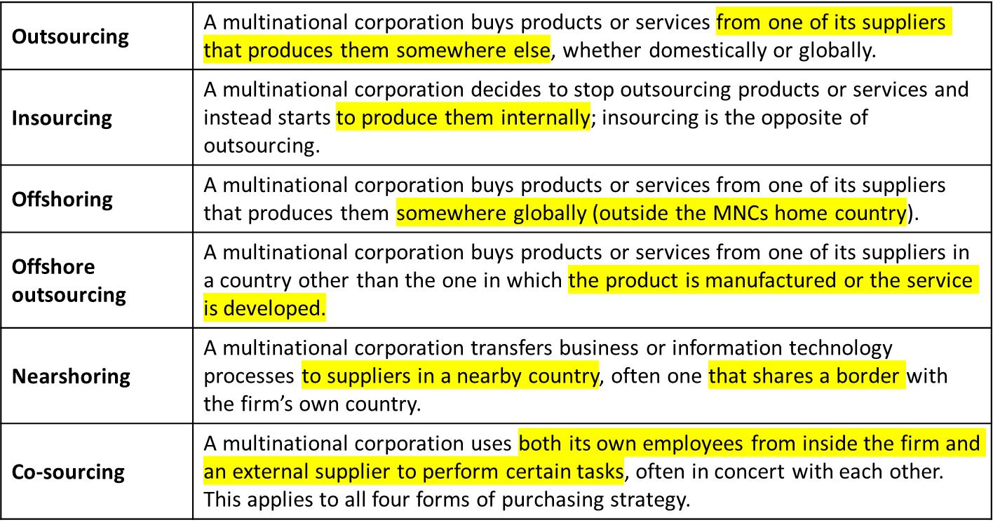
Table: Outsourcing Terms and Options
Notes:
Table above outlines the outsourcing-related terms and options that companies have, especially the following terms that are often confusing to understand, develop strategy around, and implement: outsourcing, insourcing, offshoring, offshore outsourcing, nearshoring, and co-sourcing.

Slide 20
Managing a Global Supply Chain
Efficient Supply Chain Management
  Can have a substantial impact on a firm’s profitability.
  Four important areas:
    Just-in-time inventory.
    Information technology.
    Coordination.
    Interorganizational relationships.
Notes:
For the typical manufacturing enterprise, material costs account for between 50 and 70 percent of revenues, depending on the industry. Even a small reduction in these costs can have a substantial impact on profitability.

Slide 21
Managing a Global Supply Chain
Role of Just-in-Time (J I T) Inventory
  Economizes on inventory holding costs by having materials arrive at a manufacturing plant just in time to enter the production process, and not before.
    Can result in major cost savings from reduced warehousing and inventory holding costs.
    Can help firms spot defective parts, take them out of the manufacturing process, and boost product quality.
  But leaves firms without a buffer stock of inventory, which makes it difficult to respond quickly to problems.
Notes:
To reduce the risks associated with depending on one supplier for an important input, some firms source these inputs from several suppliers located in different countries. While this may not help in the case of an event with global ramifications—such as September 11, 2001, in the United States, or the 2020 COVID19 pandemic—it does help manage country-specific supply disruptions, which are more common. Strategically, all global companies need to build in some degree of redundancy in supply chains by having multiple options for suppliers.

Slide 22
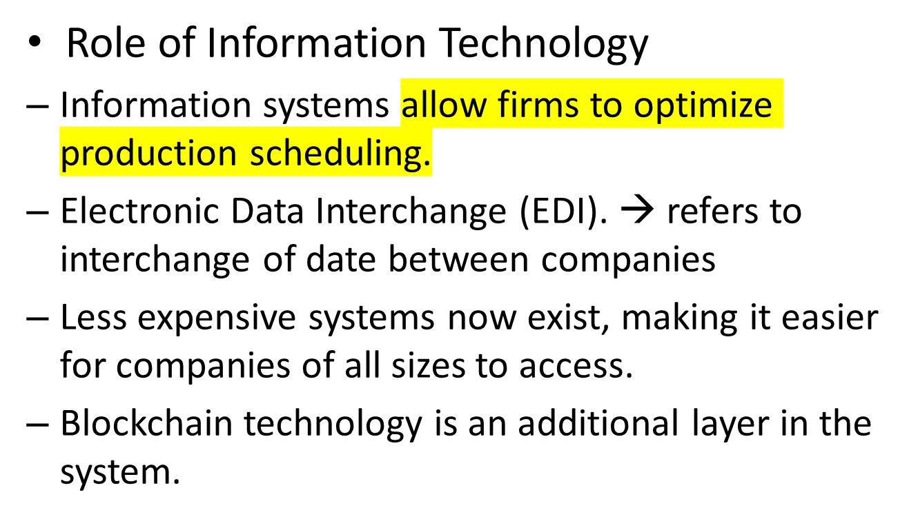
Managing a Global Supply Chain
Notes:
Electronic data interchange (EDI) refers to the electronic interchange of data between two or more companies.
Enterprise resource planning (ERP) is a wide-ranging business planning and control system that includes supply chain-related subsystems (e.g., materials requirements planning, or MRP).
Collaborative planning, forecasting, and replenishment (CPFR) was developed to fill the inter-organizational connections that ERP cannot fill. Vendor management of inventory (VMI) allows for a holistic overview of the supply chain with a single point of control for all inventory management.
A warehouse management system (WMS) often operates in concert with ERP systems; for example, an ERP system defines material requirements, and these are transmitted to a distribution center for a WMS.
Blockchain → electronic ledger (hauptbuch); everybody can put its data into the ledger and therefore has the same information
Blockchain technology makes it possible for ecosystems of supply chain partners (or any business partners) to share and agree upon key pieces of information. Blockchain technology refers to a distributed electronic ledger that has the capacity to record a variety of transaction types, such as those that occur within a supply chain.

Slide 23
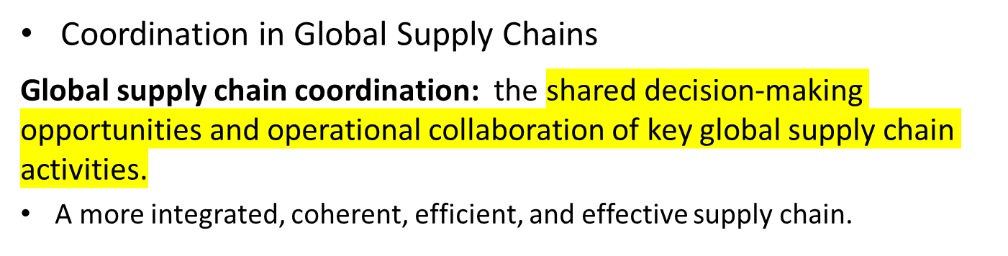
Managing a Global Supply Chain
  Operational objectives:
    Responsiveness.
    Variance reduction.
    Inventory reduction.
    Shipment consolidation.
    Quality.
    Life-cycle support.
Notes:
Responsiveness refers to a global firm’s ability to satisfy customers’ requirements across global supply chain functions in a timely manner.
Variance reduction refers to integrating a control system across global supply chain functions to eliminate global supply chain disruptions.
Inventory reduction refers to integrating an inventory system, controlling asset commitment, and turning velocity across global supply chain functions.
Shipment consolidation refers to using various programs to combine small shipments and provide timely, consolidated movement. This includes multiunit coordination across global supply chain functions.
Quality refers to integrating a system so that it achieves zero defects throughout global supply chains.
Life-cycle support refers to integrating the activities of reverse logistics, recycling, after-market service, product recall, and product disposal across global supply chain functions.

Slide 24
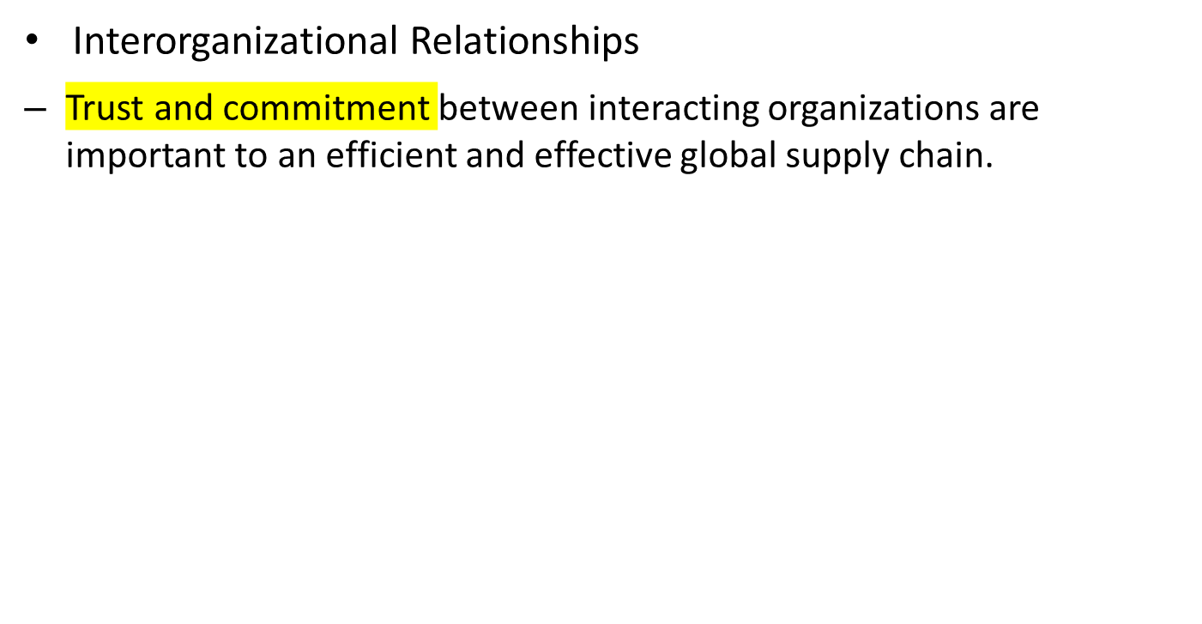
Managing a Global Supply Chain 5
Notes:
Interorganizational relationships have been studied and talked about in various contexts for decades. The two keys are trust and commitment. If we always had 100 percent trust in relationships and 100 percent commitment to them, most global supply chains would ultimately be efficient and effective.

Slide 25
Reasons Not to Outsource
“[Japanese businessmen] say producing at home helps keep innovations and new ideas from falling into rivals’ hands.”
Business Week, 19 January 2009, p. 51.
Notes:
7

Slide 26
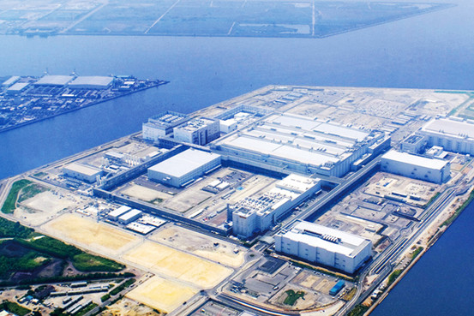
Sharp’s Stay-at-Home Factory
All their vendors are located right on their campus in Japan…no shipping, no loss of intellectual property.
Notes:
Vendor : we sell our information etc to them → possible leak of information

Slide 27
End of Global Production and Supply Chain Management Lecture

